Slide 1



E-commerce Website
E-MART
Guided By:-Prof Ronak N. Patel
Prof Martin Parmar
Prepared By:-Nishar Khorajiya-21CE057
Joisar Sujal-21CE046

Slide 2
Overview:-
Project Definition
Project Description
Objective
Major Functionalities
Technologies used in projects
Requirements
Snap of Website
References

Slide 3
Project definition
It is a E-commerce website for Ordering Products Online.
All can Order any Products at Good Price and Best Quality

Slide 4
Project Description:-
The primary goal of an e-commerce site is to sell goods online.
This project deals with developing an e-commerce website for Online Product Sale. It provides the user with a catalog of different product available for purchase in the store.
In order to facilitate online purchase a shopping cart is provided to the user.
Also if the User wants to add his own Item then he/she can add his Item and Earn Profit from it.
So Basically it is “Refer and Earn” Website.

Slide 5
Objective
The Moto Behind this website is that Any person can buy anything from mini product to large product very easily at best price and good quality .
Also if the user wants to add his own item then it can be easily added and can earn from it.
Also it is User-friendly Website.

Slide 6
Major Functionalities:-
Register
Login
Select Any items from Given Products.
Add to Cart
Bill Page.
About us.
Contact us.

Slide 7
Technologies used in Project:-
Frontend:-
Html(5)
CSS(4)
JavaScript(18.2.0)
BOOTSTRAP(5)
Backend:-
MongoDB(6.0.)
Nodejs(18.0.0)

Slide 8
Requirements
Software
Vs Code
Chrome Search Engine
Hardware
Processor : intel core i5
Memory(ram) : 8GB

Slide 9
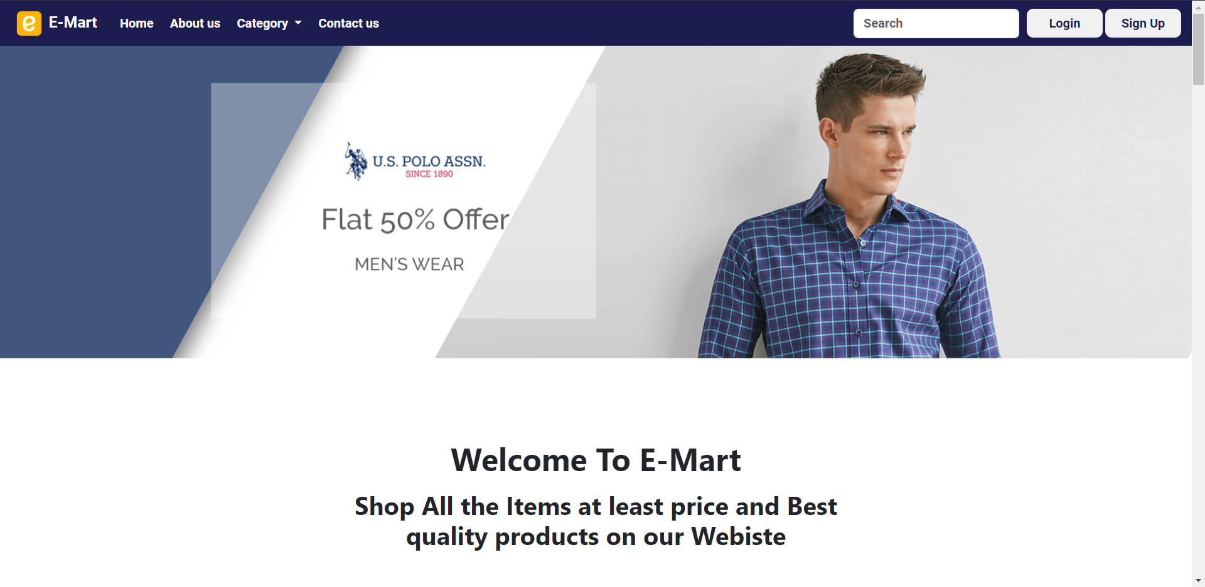
Snaps

Slide 10
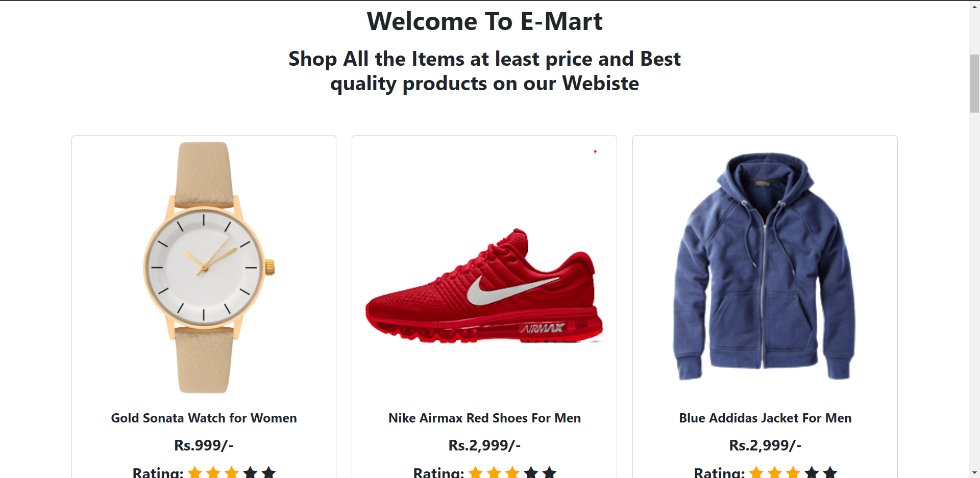
Snaps

Slide 11
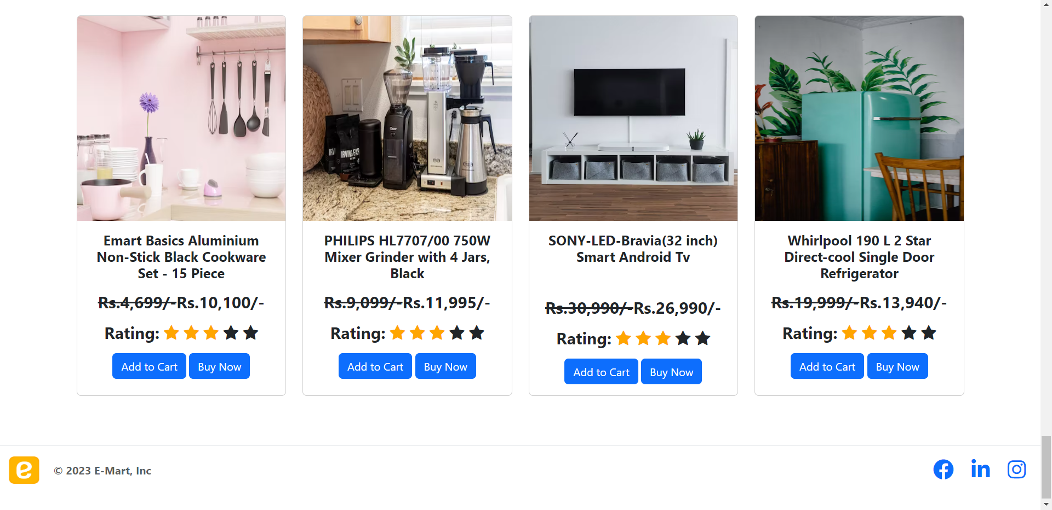
Snaps

Slide 12

Snaps

Slide 13

Snaps

Slide 14
Reference
https://www.youtube.com/watch?v=yfpoT0YKSIc
https://www.youtube.com/watch?v=2DUJvbw6jTA

Slide 15
THANK-YOU

